Slide 1

CREATOR MEDIA KIT · 2026
Steph Brashear
@steph.goes.with.that · TikTok · Instagram · Facebook
EMDR Therapist & EMDRIA Approved Consultant —
talking to the therapists who buy your software and the clients who influence them.
TikTok
Instagram
Facebook
Notes:
Cover slide. Update "2026" each year. The tagline is written for practice management software companies — customize per pitch.

Slide 2
THE OPPORTUNITY
Why This Partnership Works
01
Dual Audience Reach
Her audience
is your
customer.
She reaches both therapists evaluating software AND clients who influence their therapist's buying decisions.
02
Clinical Credibility
As an EMDRIA Approved Consultant, her product recommendations carry professional weight — not just influencer noise.
Half her audience are therapists shopping for better tools. The other half are clients who just sent her video to their own therapist. Both groups trust her. Both buy things.
You mean therapy comes with a built-in product research pipeline? But we don't have to get into all of that. When she recommends something, it doesn't feel like an ad. It feels like advice from someone who actually does this work — because she does.
03
Viral Organic Reach
Instagram hit 4.1M views in August alone — 97.9% from non-followers. Sponsored content rides the same algorithm.
Notes:
Customize the company names (SimplePractice, TherapyNotes, etc.) to match whoever you're pitching. This is the most important slide for B2B software companies.

Slide 3
PLATFORM REACH
By the Numbers
TIKTOK
INSTAGRAM
FACEBOOK
390.6K
4.1M
209
Total Likes
Monthly Views
Followers
2,532 followers
8,848 followers · 309 posts
Growing audience
Individual videos reach 3M+ views
97.9% views from non-followers
Linked to IG presence
Notes:
v4 update: Instagram now leads with 4.1M monthly views (August 2026 actual). TikTok sub2 updated to reflect 3M+ individual video reach. Update quarterly.

Slide 4
Licensed EMDR Therapist & EMDRIA Approved Consultant
Stephanie Brashear is a licensed EMDR therapist, EMDRIA Approved Consultant, and — based on the comment sections — everyone's parasocial therapist. She talks about trauma, EMDR, and the messier parts of healing the way someone talks when they've actually sat with it.
Her audience doesn't just watch. They screenshot, save, and DM her videos to their own therapist. That kind of trust doesn't come from a content calendar — it comes from credibility. But we don't have to get into all of that.
Half her followers are therapists making active decisions about practice tools. The other half are clients who influence those decisions. You mean therapy comes with accountability to the product stack? One channel, both sides of the sale.
ABOUT & CREDENTIALS
Steph Brashear
@steph.goes.with.that
"A popular mental health creator and EMDR consultant known for sharing relatable insights on therapy and emotional healing."
EMDRIA Approved Consultant
Licensed RI · SC · OH
CPTSD Specialist
Religious Trauma
IFS Practitioner
— Google AI Overview
Notes:
EMDRIA Approved Consultant is an important credential — it means she can supervise other therapists in EMDR, which significantly raises her authority with clinician audiences.

Slide 5
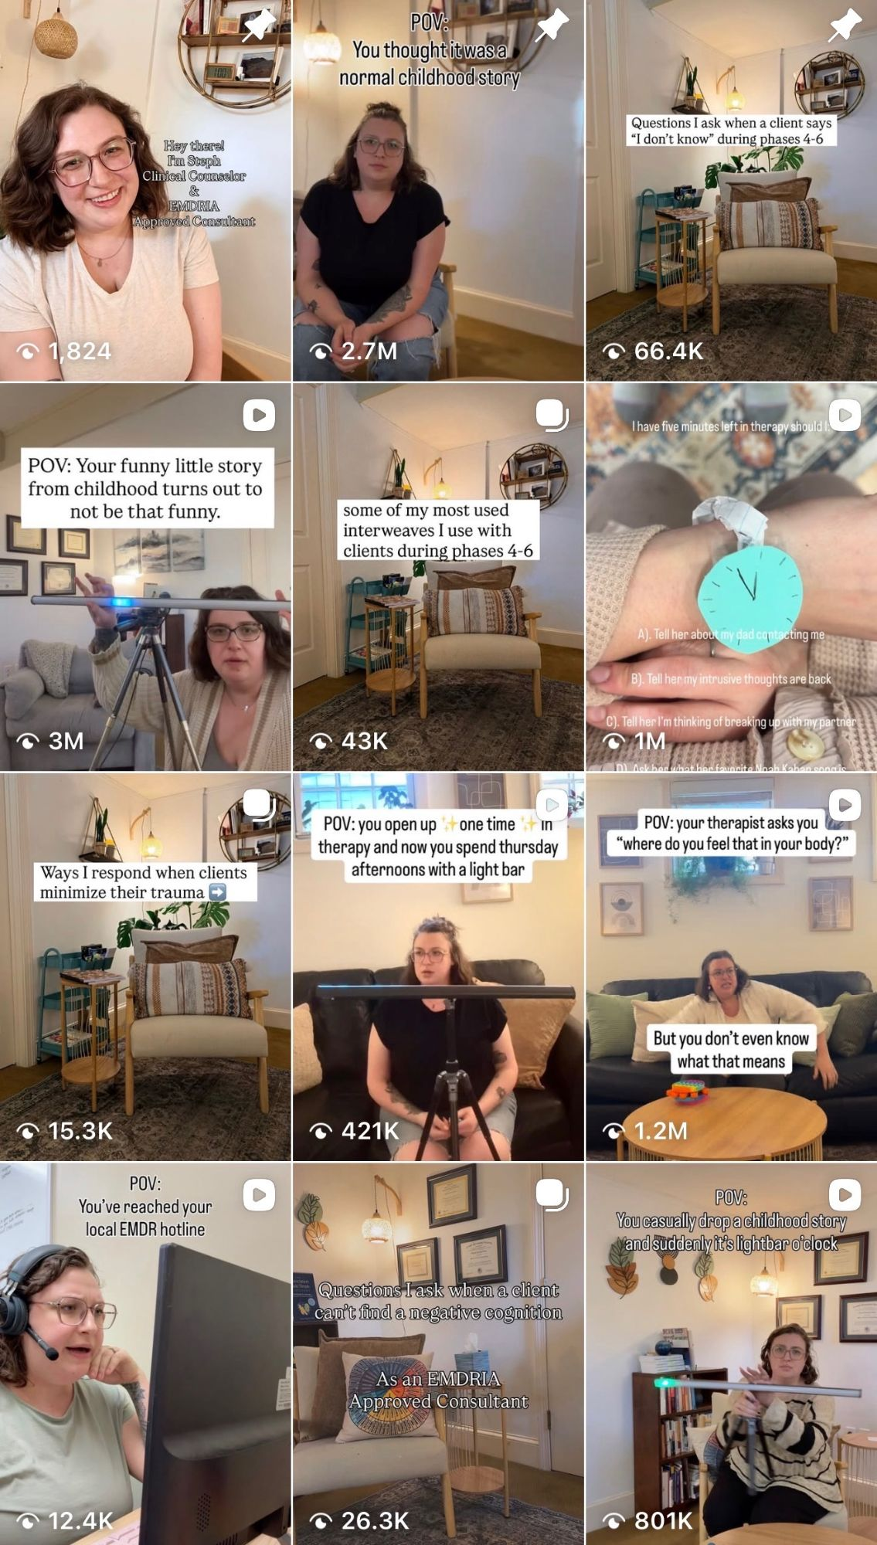
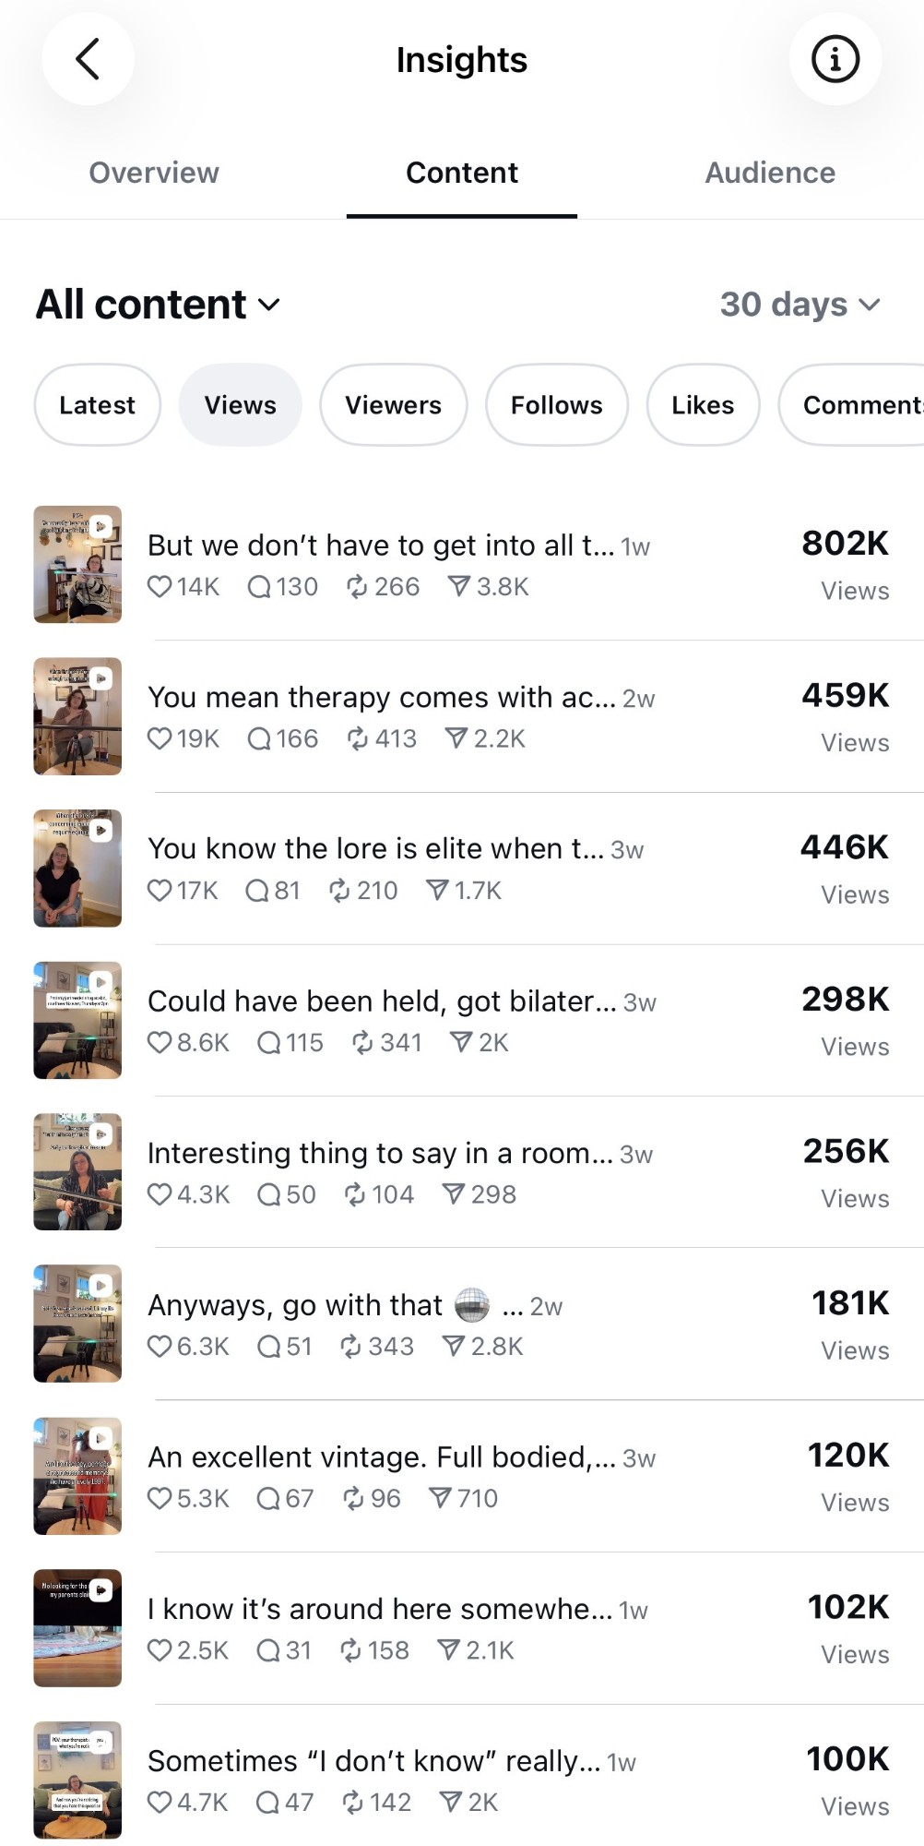
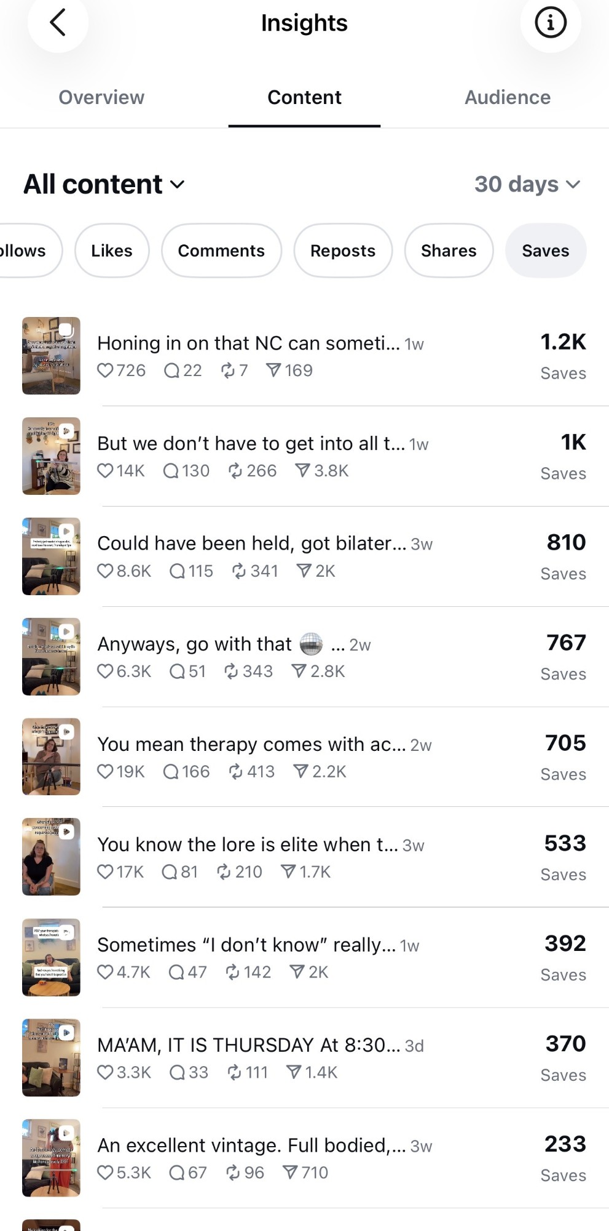
SAMPLE CONTENT
Content in Action
TIKTOK
INSTAGRAM — TOP REELS
INSTAGRAM — SAVES
Videos reach 3M+ views
802K top reel · 4.1M/month
1.2K saves on top post
TikTok content — viral reach across therapy & EMDR topics
Last 30 days: 9 videos above 100K views
High-save content = clinicians bookmarking for practice use
Notes:
v4: Real analytics screenshots embedded. Left = TikTok grid (viral all-time content). Middle = Instagram top reels by views (30 days). Right = Instagram top by saves (30 days — saves signal clinician utility).

Slide 6
CONTENT FOCUS
What Her Audience Comes For
EMDR Therapy
IFS — Internal Family Systems
CPTSD & Complex Trauma
Eye Movement Desensitization & Reprocessing — science and lived experience for clients AND clinicians
Parts work and self-leadership explained in a way therapy clients and trainees actually understand
Symptoms, patterns, and healing pathways for survivors and the therapists supporting them
Religious Trauma
Clinician Education
Therapy Demystified
A niche with massive engagement and very few other credentialed clinician voices addressing it
Content for therapists in training, EMDR consultation, and private practice-building decisions
What therapy actually looks like, how to find a therapist, and what to expect — for the general public
Notes:
"Religious Trauma" is worth calling out — highly searched topic with almost no other credentialed creator voices. Strong differentiator in pitch conversations.

Slide 7
PARTNERSHIP OPPORTUNITIES
Rates & Deliverables
DELIVERABLE
INCLUDES
RATE
TikTok Sponsored Video
Dedicated 60–90 sec., story-driven integration, 30-day usage rights
$650
Instagram Reel
Dedicated Reel, caption, tags, Story share, link in bio 14 days
$500
Instagram Carousel Post
Educational slide post — ideal for apps, tools, or book promos
$350
Story Set (3 frames)
3-slide swipe with link sticker — strong click-through for SaaS tools
$225
Facebook Post
Sponsored post with link — cross-posted from IG where appropriate
$125
Bundle — TikTok + Reel + Stories
Full cross-platform launch — coordinated release across 3 channels
$1,150
Bundle — Full Package (+ Carousel)
TikTok + Reel + Carousel + Story Set — best value for product rollouts
$1,400
MONTHLY AMBASSADOR PROGRAMS
Light Ambassador
2 short-form videos + 2 Story sets + 1 carousel — 3-month minimum
$1,750–$2,250/mo
Core Ambassador
4 short-form videos + 4 Story sets + 2 carousels — 3-month minimum
$2,750–$3,500/mo
Add-ons priced separately: paid ad rights +30–50% · whitelisting/Spark Ads +40–60%/mo · category exclusivity +20–40% · extra revision $100 · rush +25%
Notes:
PRICING NOTES: - These are published (full) rates. Internal negotiation floor: TikTok $450, Reel $350, Carousel $250, Stories $175, FB $100, Core Bundle $900, Full Bundle $1,100. - For a first partnership, offer the negotiation-floor rate in exchange for permission to publish results as a case study. - Monthly packages start with 3-month commitments. Exclusivity is always an add-on, never included.

Slide 8
LET'S PARTNER
Stephanie Brashear
EMDR Therapist · EMDRIA Approved Consultant
You mean she reads every email herself? She does. No gatekeepers.
TikTok: @steph.goes.with.that
Instagram: @steph.goes.with.that
Facebook: Steph Goes With That
Email: Steph.Goes.With.That@RootandGrowProvidence.com
Notes:
Contact: Steph.Goes.With.That@RootandGrowProvidence.com

